Slide 1


Green Pace
Security Policy Presentation
Developer: Chad Nadeau

Slide 2


OVERVIEW: DEFENSE IN DEPTH
Security policies are crucial for safeguarding organizational assets, ensuring regulatory compliance, and mitigating security risks. They establish clear guidelines and responsibilities to prevent breaches, promote awareness, and maintain operational resilience in evolving threat environments.

Slide 3
THREATS MATRIX
Threat matrices categorize risks based on likelihood and priority, helping organizations focus on the most probable and impactful threats while allocating fewer resources to less significant ones.
Likely High probability threats that require immediate attention and strong mitigation. | Priority High relevancy, requires immediate action/attention.
Low priority Lower relevancy, requires less action/attention that high priority. | Unlikely Rare threats with minimal impact, requires minimal resources.

Slide 4
10 PRINCIPLES
Validate Input Data
Heed Compiler Warnings
Architect and Design for Security Policies
Keep It Simple
Default Deny
Adhere to the Principle of Least Privilege
Sanitize Data Sent to Other Systems
Practice Defense in Depth
Use Effective Quality Assurance Techniques
Adopt a Secure Coding Standard

Slide 5
CODING STANDARDS
Never hard code sensitive information
Do not form or use out-of-bounds pointers or array subscripts
Ensure that unsigned integer operations do not wrap
Free dynamically allocated memory when no longer needed
Close files when they are no longer needed
Guarantee that storage for strings has sufficient space for character data and the null terminator
Exclude user input from format strings
Detect and handle standard library errors
Allocate sufficient memory for an object
Declare objects shared between threads with appropriate storage durations

Slide 6
ENCRYPTION POLICIES
Encryption in Rest – The process of encrypting data while it is not being used or while it is stored on a device such as a hard drive.
Encryption at Flight – The process of encrypting data while it’s being transmitted across a network.
Encryption in Use – The process of encrypting data while it is actively being used in memory, such as an application or program.

Slide 7
TRIPLE-A POLICIES
Authentication – Only legitimate users or systems can access resources by verifying their identity.
Authorization - Authenticated users or systems are only granted the specific permissions or access they need, according to their role, rights, or policies.
Accounting - Track and record user activities and system events to ensure compliance and detect potential security incidents.

Slide 8
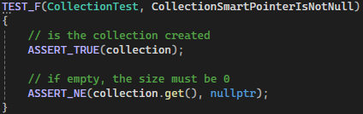
Unit Testing
CollectionSmartPointerIsNotNull

Slide 9
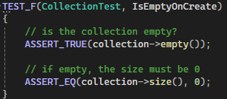
Unit Testing
IsEmptyOnCreate

Slide 10
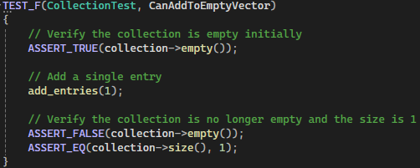
Unit Testing
CanAddToEmptyVector

Slide 11

Unit Testing
CanAddFiveValuesToVector

Slide 12

AUTOMATION SUMMARY

Slide 13
TOOLS
A DevSecOps pipeline is an integrated approach to software development and deployment that incorporates security practices throughout the entire Continuous Integration/Continuous Deployment (CI/CD) pipeline. It aims to make security a shared responsibility across development, security, and operations teams, ensuring that security is embedded into every stage of the software lifecycle.
External tools in a DevSecOps pipeline automate security practices throughout the software development lifecycle. Key tools include Static Application Security Testing (SAST) for static code analysis, Dynamic Application Security Testing (DAST) for testing running applications, Software Composition Analysis (SCA) for managing third-party dependencies, and Infrastructure as Code (IaC) security tools for configuration checks. These tools are integrated into CI/CD pipelines to continuously scan for vulnerabilities, enforce security best practices, and ensure compliance, providing real-time feedback and improving overall security posture.

Slide 14
RISKS AND BENEFITS
Without a clear security policy, organizations risk breaches, data loss, and non-compliance. Implementing a policy now provides immediate protection and better risk management, though it requires some initial effort. Waiting only increases the chances of security gaps and costly incidents. To stay ahead, companies should create clear policies, integrate security into development, and keep employees trained and informed.

Slide 15
RECOMMENDATIONS
Lack of Regular Updates: Security policies may become outdated without regular updates, leaving new threats unaddressed.
Insufficient Employee Training: Employees may not be adequately trained on security best practices, increasing the risk of phishing or other social engineering attacks.
Weak Incident Response Plans: Without a detailed, tested incident response plan, organizations may struggle to respond effectively to security breaches.
Poor Integration with Development Processes: Security may be treated as a separate, after-the-fact process rather than being integrated into the CI/CD pipeline, leaving gaps in vulnerability scanning and code review.

Slide 16
CONCLUSIONS
Implementing security policy standards helps a company proactively protect sensitive data, reduce risks, and ensure compliance with industry regulations. By standardizing security policies, a company not only safeguards its assets but also builds trust with customers, partners, and regulatory bodies, ensuring long-term operational stability and reputation.

